Slide 1
Nykaa GenZ SkinCare Launch: Clean, Viral and Sustainable
Ppt by Tapaswini Pati

Slide 2
TARGET MARKET
The specific group of consumers most likely to buy the company’s specific product, defined by shared chracteristics like demographics, needs and behaviors.
Demographics
.
Age: 16-25 years old (genz)
Location: Urban and semi-urban India
Income level: Students and young professionals who are price sensitive but value driven
Gender: all genders
Tech profile: 8+ hours active on social platforms like instagram, pinterest, youtube
Psychographics
VALUES
demands clean ingredient lists, hates “greenwashing”
prefers eco-friendly, cruelty-free, vegan products
BEHAVIOR
social media influence: discovers trends via influencers. Eg: “glass skin trend”
trusts peer reviews and only buys after viewing 3+ influencer reviews
PAIN POINTS
acne/oily skin concerns
more interest towards traditional natural brands

Slide 3

WHY OUR SKINCARE BRAND STANDS OUT ?
Nykaa’s 1st 100% circular skincare line
plant based packaging, refillable containers
zero waste promise ( bio-degradable labels)
50% less plastic than competitors
Skin-loving Formulae
No parabens, sulfates or synthetic fragnances
QR code reveal ingredient sourcing (blockchain backed
transparency)
pH-balanced for indian skin + pollution protection
Targeted solutions: Acne-control, hydration and anti pollution formulas

Slide 4
CORE PRICING STATEGY
Penetration Pricing
Launcing the product at low price in compared to competitors but gradually increasing the price after gaining market share.
Affordable Premium Positioning
Price range : rs.249 - rs.799 [ available at various sizes, and with different mixture of ingredients comes various prices ]
Psychology: slightly above drugstore signals quality but 30% below global clean brands shows affordability
Psychological pricing
rs.499 instead of rs.500 created a psychological appearance of more affordability
“Buy 2, Get 1 free” : creates a state of very valuable urgency
GenZ hack : “exclusive offers for students” ; along with social proof could invite high traffic
Freemium Model
Free mini sample with rs.799+ orders
Flash sales and discounts at special occasions results with more purchases
Value-based Pricing
Charge rs.699 by highlighting “1 bottle = 10 trees planted”
This aligns with genz’s activism values

Slide 5
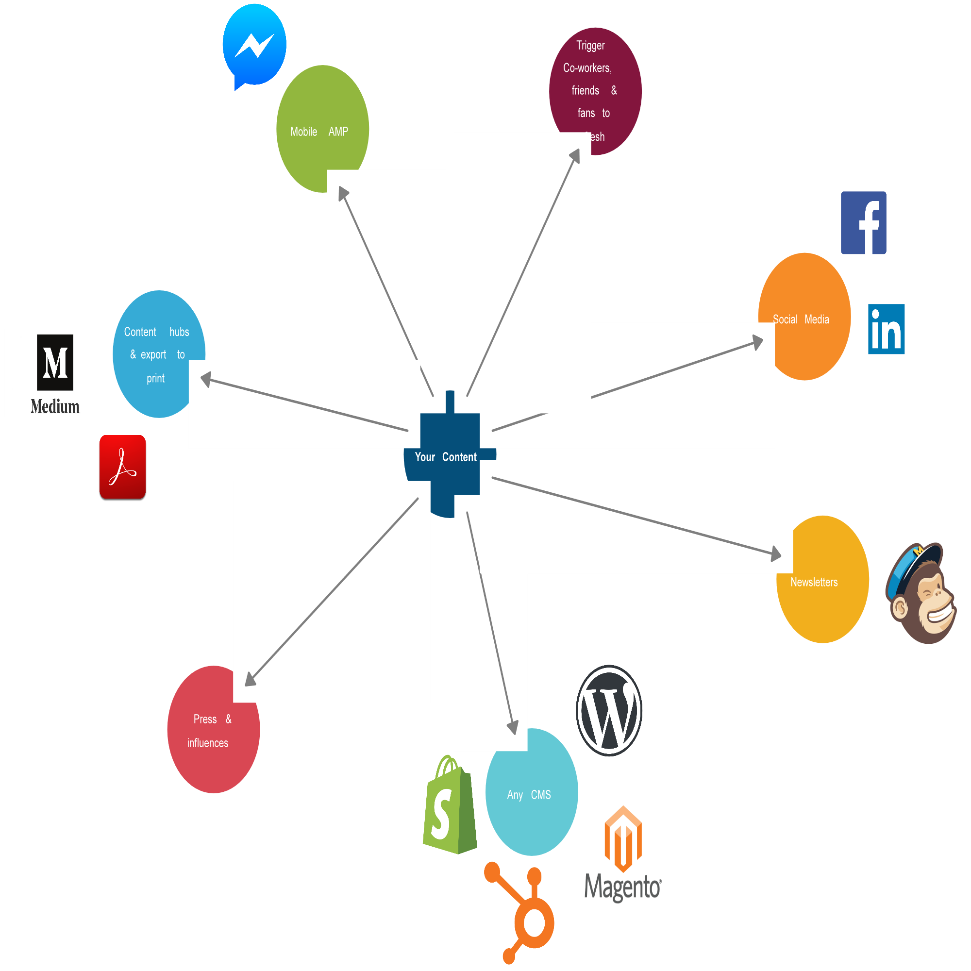
PRODUCT PLACEMENT AND DISTRIBUTION STRATEGY
Omnichannel Distribution- where GenZ shops
DIGITAL FIRST ( SOCIAL PRESENCE )
Nykaa’s App
dedicated “ GenZ clean beauty” carousel on homepage.
“ Try On” AR filter for skincare diagnostics
Social Media E-Commerce
Instagram Shops
WhatsApp Commerce to place orders via chatbot
OFFLINE DISTRIBUTION ZONES
Nykaa Stores
Interactive ecostations - Scar QR codes to see product
lifecycle at storefront
Free mini facials with purchase offer
Campus Pop-Ups - Partner with college fests
Recycling drives campaigns

Slide 6
Gen-Z promotion Strategy
#NykaaGreenGlowUp challenge
Mechanics: (Viral Challenge)
Users post “bare face --> glow up” videos using the specific Nykaa products.
Most creative wins cash prize/gift hamper featured on Nykaa app -- this initiative will drive heavy traffic (especially females)
Platforms: Instagram Reels/TikTok/YouTube Shorts (70% of genz discover brands and products here)
Micro Influencer Army
Collaborating with influencers for the engagement and buyers boosting of the product. It works because viewers trust micro influencers and find their product review + storytelling credible. It is UGC driven.
Nano(5k-50k followers): unboxing + ingredient breakdowns and benefits
Micro(50k-200k): “day in my life/ 5-step sustainable skincare routine” vlogs
Influencers posting “My skincare vs nykaa’s green routine” with new product showing before/after comparisions.
Social proof: Collab with social media dermatologist influencers to promote the product
Gamified Loyalty
Spin the wheel-- discounts for reviews
“Streaks” rewards for daily check in/ free product at puchasing above a specific price range

Slide 7
THANK YOU

